Slide 1

QORVO_RADIO2
10/22/2025 Meeting

Slide 2
Agenda
KiCad Development
General Announcements

Slide 3
KiCad Development
Completed
All footprints completed and checked for errors
Revised symbols
Add zero ohm resistors for low pass rc filters at speaker
Combined all completed sub circuits onto on circuit schematic.
Created Pinout headers for all external components
To-do
Antenna circuit design
Developing PCB layout

Slide 4
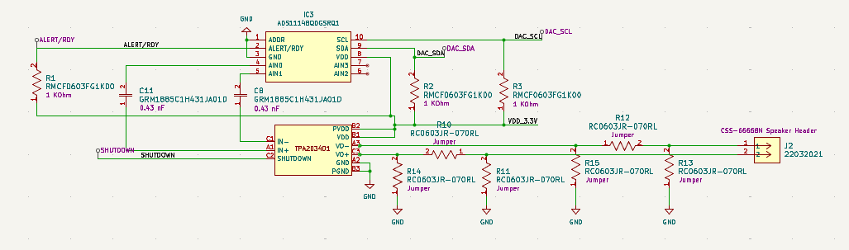
RC Filters (0 Ohm resistors)

Slide 5
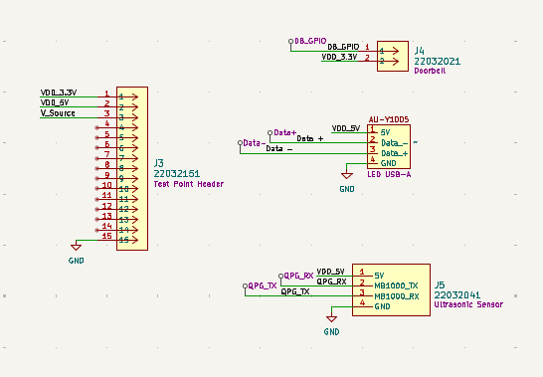
Pinout headers

Slide 6
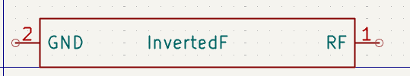
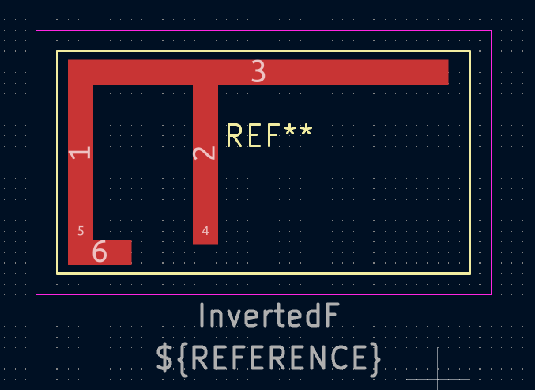
Inverted F Antenna Symbol and Footprint

Slide 7
General Announcements
PDR
11/7/2025 at 9am
EPIC 3226
Purchase Requisitions

